Slide 1
ForeSite_RPOC Data Manager
Procedure to add new parameter definition and Project File

Slide 2
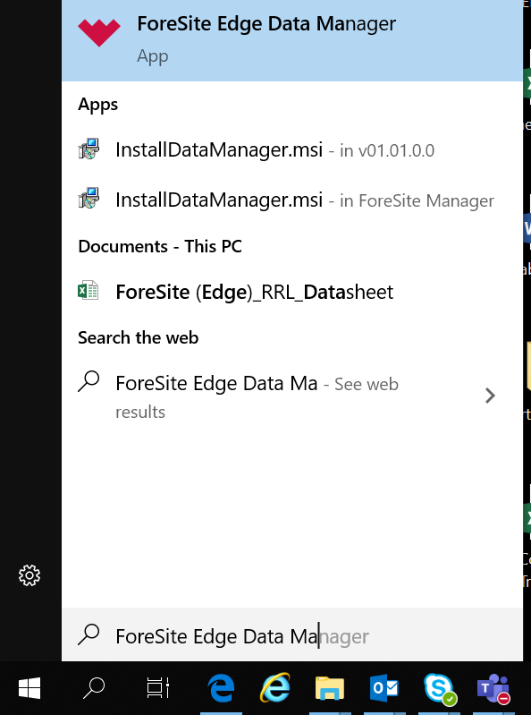
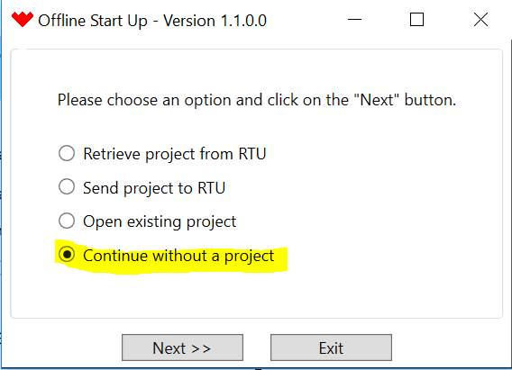
1.Download ForeSite_RPOC Data Manager.zip and install the application.​ 2. Download copy the below files to desktop.​ - 3.07.03_Project.xml and ​ - RPOC_ParameterDefinition_v030804.xml to desktop​

Slide 3
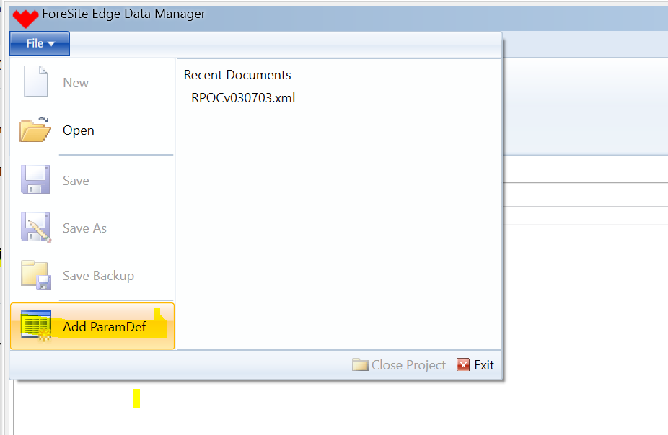
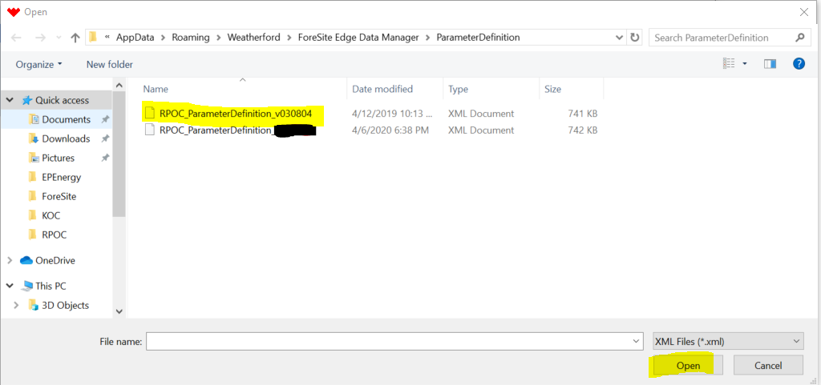
2. Press file menu and select Add ParamDef option.
3. Select RPOC_Parameterdefinition_v030804 file and OPEN

Slide 4
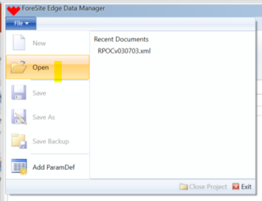
4. Adding new project file – Press file menu and select Open folder option 5. Copy the RPOC_v030703 project file to the project folder 6. Download and follow RPOC DM Training pdf for connecting to RPOC and manual for further steps.

